Slide 1
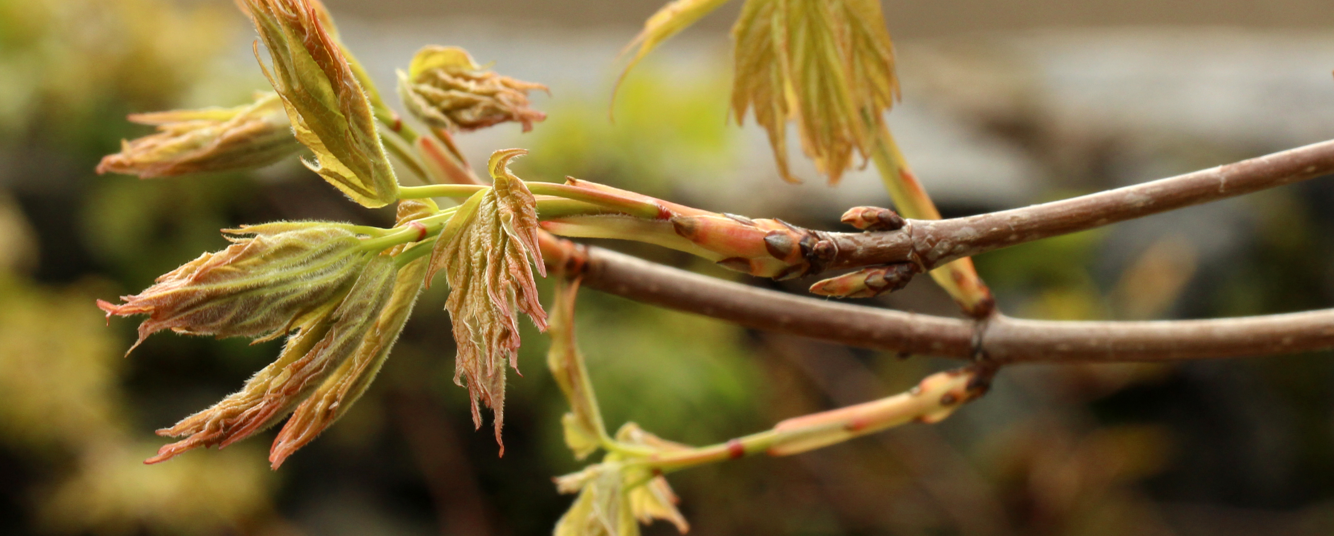
Photo Cred: Suz Mrozak
Understanding budburst and leafout in a warming world
Examining microclimatic effects

Slide 2
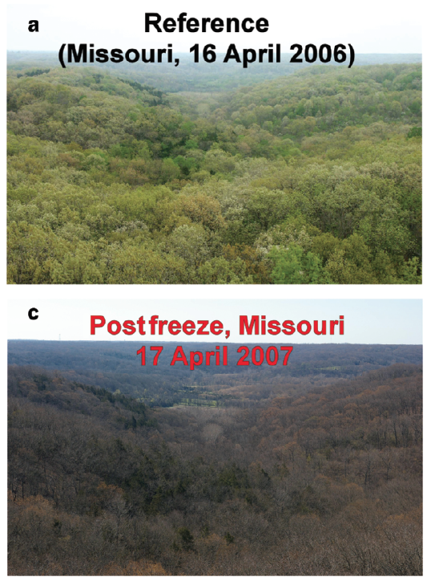
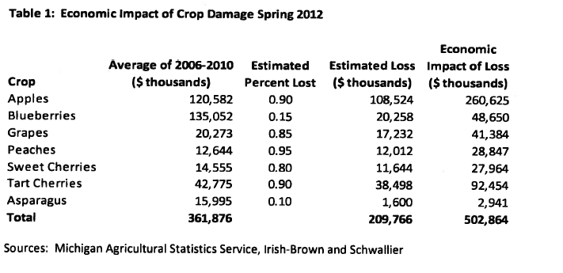
MASSIVE ECONOMIC AND ECOLOGICAL CONSEQUENCES
Gu et al, 2008
Knudson, 2012
Notes:
Talk here about the different phases and consequences of vegetative vs reproductive
16-38 days leafless and recovery time – scale that up and if freezing events are becoming more prevalent, could have major implications for carbon storage.

Slide 3
Frost tolerance
Phenology:
timing of life-history events
Over-Winter Chilling
Spring Warming
Daylength
Duration of Vegetative Risk

Slide 4
Growing Degree Days
Definition: accumulation of spring warming temperatures
If temperature is greater than 0℃, then you add up the temperatures
Temp (℃) – 0 ℃ = X
E.g., Temperature is 5 ℃ for Day 1, 7 ℃ for Day 2 and -2 ℃ for Day 3
Day 1: 5 – 0 = 5
Day 2: 7 – 0 = 7
Day 3: -2 - 0 = 0 (doesn’t count)
So by Day 3, 12 GDDs (5+7) have been accumulated.

Slide 5
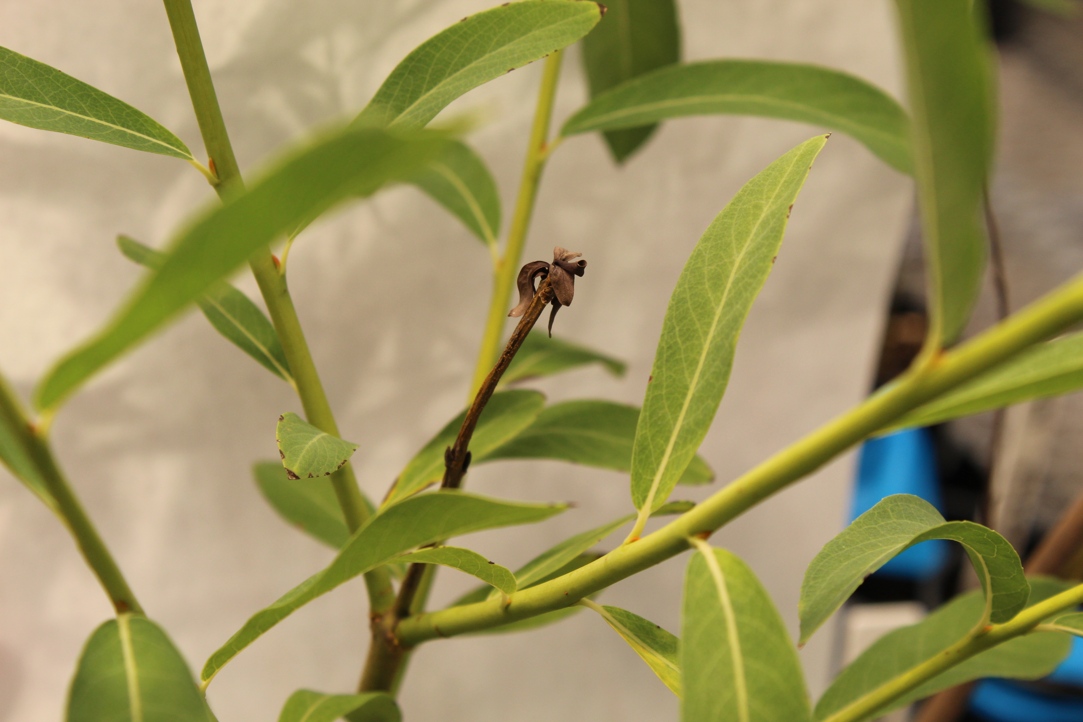
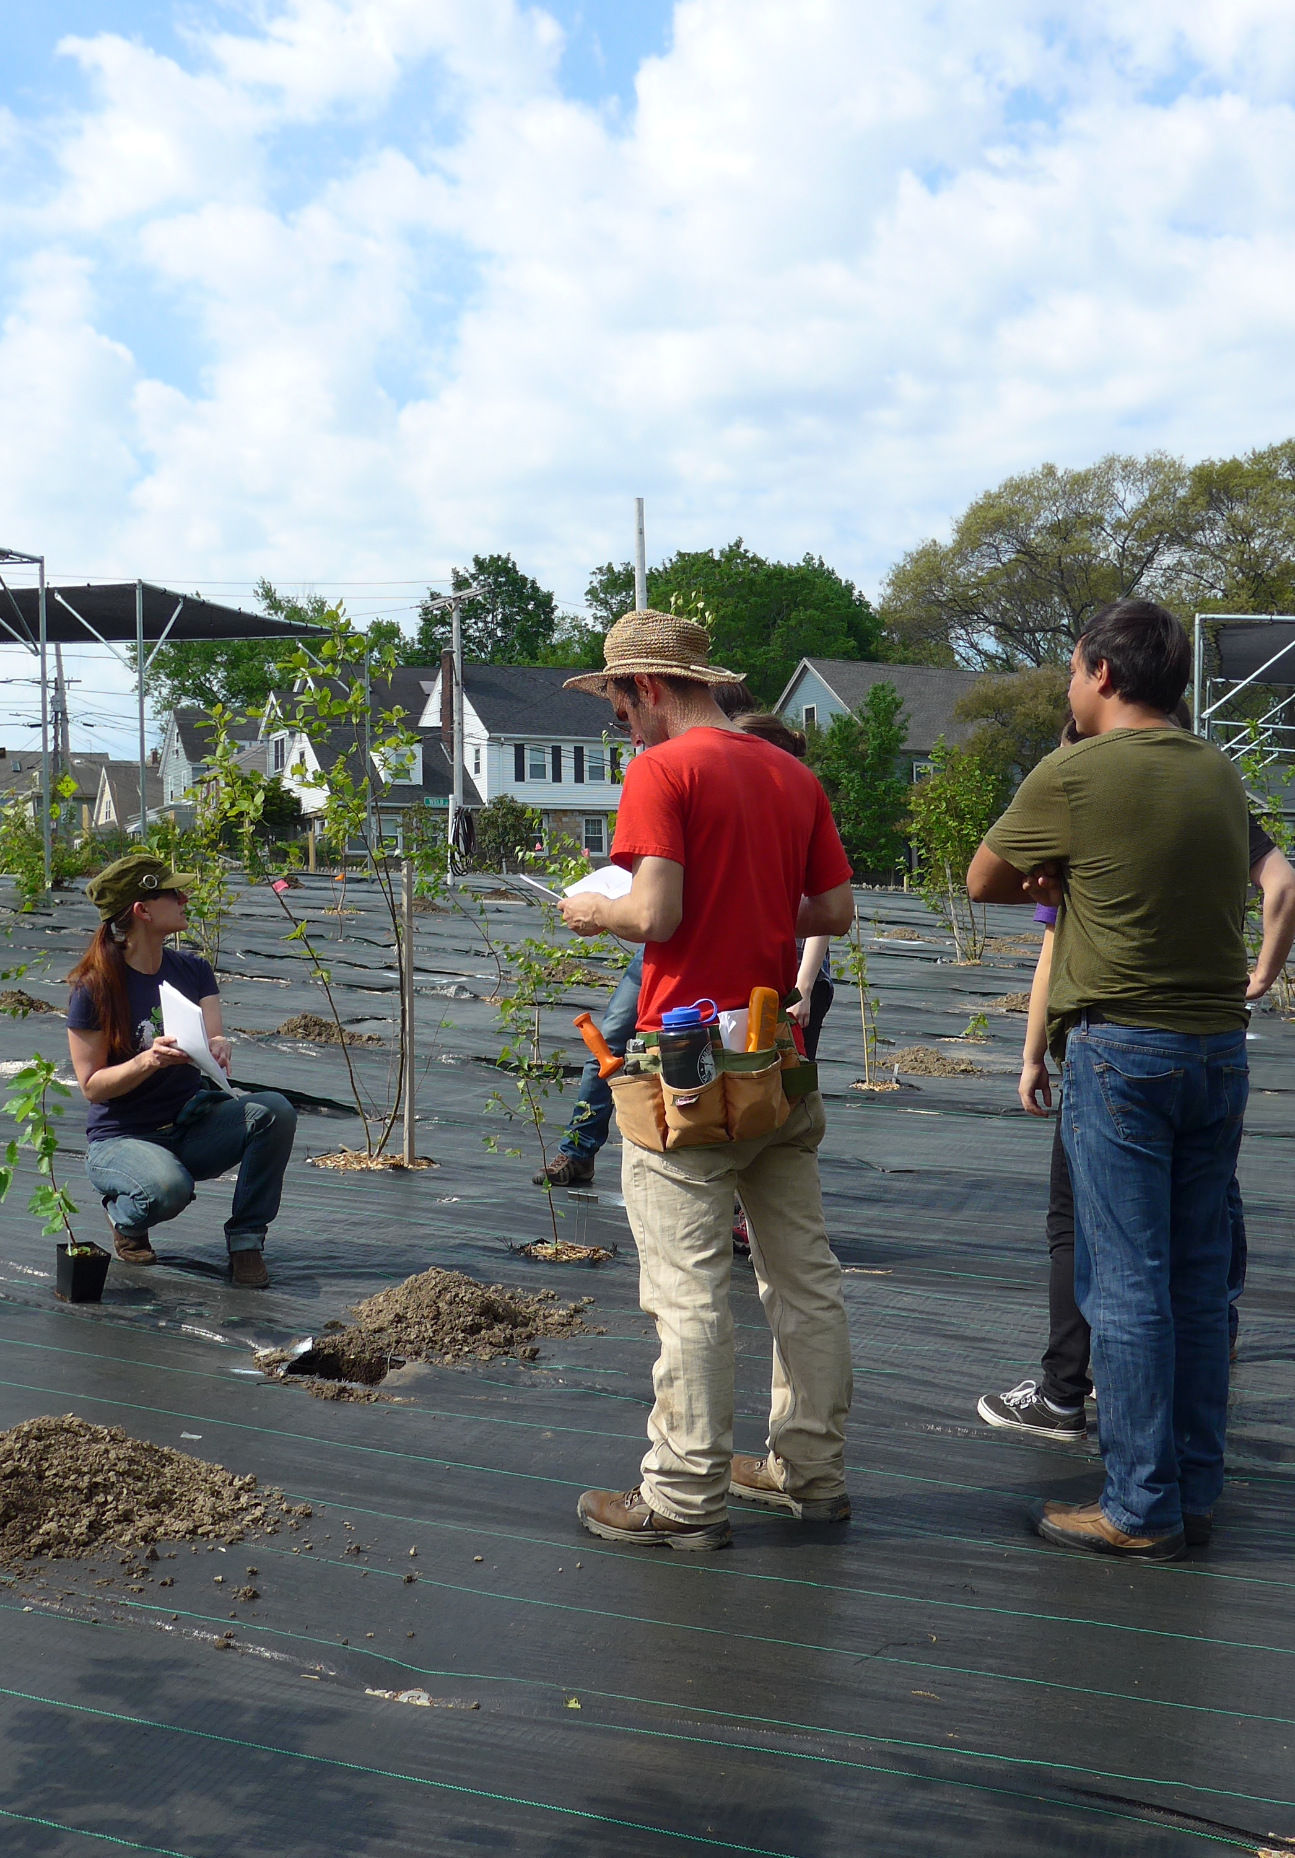
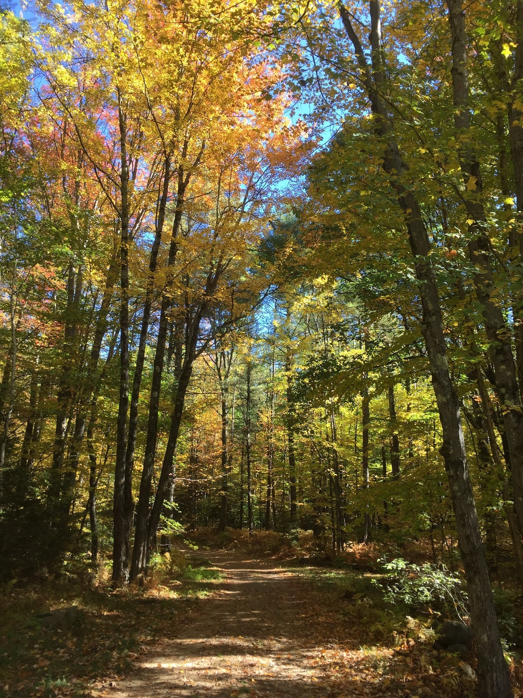
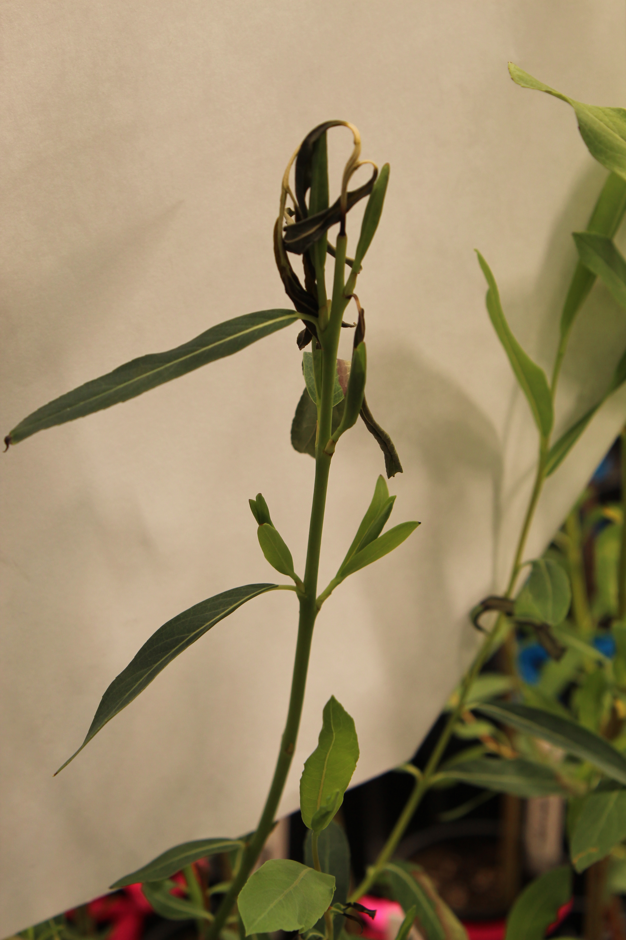
Drought Risk
Spring Freeze Risk
Growth Rate
Carbon Sinks

Slide 6
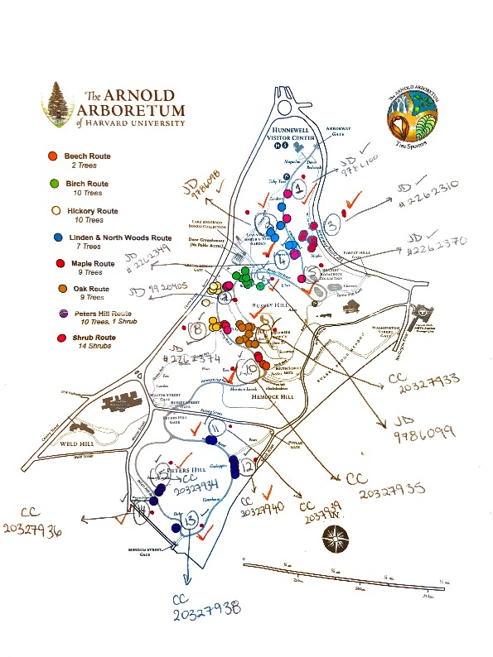
How do I test this?

Slide 7
Can we use Weather Station climate data to calculate GDDs?

